Slide 1



CSS Chapter 3
Transforms, Transitions, Animations & Media Query

Slide 2

CSS3 2D Transforms
With CSS3 transform, we can move, scale, turn, spin, and stretch elements.
How Does it Work?
A transform is an effect that lets an element change
shape, size and position.
2D Transform methods
Translate()
Rotate()
Scale()
Skew()
Matrix()

Slide 3
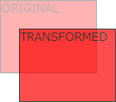
Transform Translate
With the translate() method, the element moves from its current position, depending on the parameters given for the left (X-axis) and the top (Y-axis) position.
The syntax : translate(X, Y).
Example
trnsform: translate(50px,100px);

Slide 4
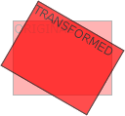
Transform Rotate
With the rotate() method, the element rotates clockwise at a given degree. Negative values are allowed and rotates the element counter-clockwise.
The syntax transform: rotate(30deg);
Example
transform: rotate(30deg);

Slide 5
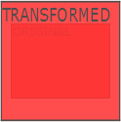
Transform Scale
With the scale() method, the element increases or decreases the size, depending on the parameters given for the width (X-axis) and the height (Y-axis).
The syntax transform: scale(x, y);
Example
transform: scale(2,4);

Slide 6
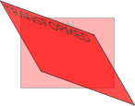
Transform Skew
With the skew() method, the element turns at a given angle, depending on the parameters given for the horizontal (X-axis) and the vertical (Y-axis) lines.
The syntax transform: skew(30deg, 20deg);
Example
transform: skew(30deg,20deg);

Slide 7
Transform Matrix
The matrix() method combines all of the 2D transform methods into one.
The matrix method takes six parameters, containing mathematic functions, which allow you to: rotate, scale, move (translate), and skew elements.
The syntax transform: matrix(a, b, c, d, e, f).
Example
transform: matrix(0.866,0.5,-0.5,0.866,0,0);

Slide 8
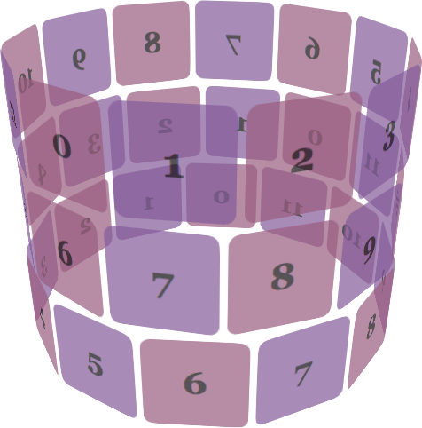
CSS 3D Transforms
3D transform methods:
rotateX() rotateY() rotateZ()

Slide 9

3D Transform Rotate X
With the rotateX() method, the element rotates around its X-axis at a given degree.
The syntax transform: rotateX(angle);
Example
transform: rotateX(120deg);

Slide 10

3D Transform Rotate Y
With the rotateY() method, the element rotates around its Y-axis at a given degree.
Example
transform: rotateY(130deg);

Slide 11

3D Transform Rotate Z
With the rotateZ() method, the element rotates
around its Z-axis at a given degree.
Example
transform: rotateZ(130deg);

Slide 12
Transitions in CSS-3
CSS3 transitions allow you to add smooth and gradual changes to the CSS properties of an element, such as its colour, size, or position.
Here also learn about the following properties:
transition-delay
transition-duration
transition-property
transition-timing-function

Slide 13
Transition-Delay
The transition-delay property specifies when the transition effect will start.
The transition-delay value is defined in seconds (s) or milliseconds (ms). Transition-Duration
The transition-duration property specifies how many seconds (s) or milliseconds (ms) a transition effect takes to complete.

Slide 14
Transition-Timing-Function
The transition-timing function property specifies the speed curve of the transition effect.
The transition-timing-function property can have the following values:
ease - specifies a transition effect with a slow start, then fast, then end slowly.
linear - specifies a transition effect with the same speed from start to end.
ease-in - specifies a transition effect with a slow start.
ease-out - specifies a transition effect with a slow end.
ease-in-out - specifies a transition effect with a slow start and end.
cubic-bezier(n,n,n,n) - lets you define your own values in a cubic-bezier function.

Slide 15

Transition-Property
The transition-property specifies the name of the CSS property the transition effect is for (the transition effect will start when the specified CSS property changes.
Example
transition-property: color;

Slide 16
Animations
With CSS3, we can create animations that replace animated images, Flash animations, and JavaScript in many web pages.
CSS3 @keyframes Rule
The @keyframes rule is where the animation is created. Specify a CSS style inside the @keyframes rule and the animation will gradually change from the current style to the new style.
Specify when the change will happen in per cent, or the keywords "from" and "to", which is the same as 0% and 100%.

Slide 17

Example:
@keyframes myfirst{
0% {background: red;}
25% {background: yellow;}
50% {background: blue;}
100% {background: green;}
}
@-webkit-keyframes myfirst {
0% {background: red;}
25% {background: yellow;}
50% {background: blue;}
100% {background: green;}
}

Slide 18
Properties included in animations
animation-name
animation-duration
animation-delay
animation-iteration-count
animation-direction
animation-timing-function
animation-fill-mode
animation

Slide 19
Media Query
Media query is a CSS technique introduced in CSS3
It uses the @media rule to include a block of CSS properties only if a certain condition is true.
Media queries will allow us to change our layouts to suit the extract need of
different devices – without changing the content
CSS can be used to specify how a document is presented in different media.

Slide 20
Example:
<!DOCTYPE html>
<html>
<head>
<meta name="viewport" content="width=device-width, initial-scale=1.0">
<style>
body {
background-color: lightgreen;
}
@media only screen and (max-width: 600px) { body {
background-color: lightblue;
}
}
</style>
</head>
<body>
</body>
</html>

Slide 21
Media query syntax: external
<link href="narrow.css" rel="stylesheet" media="only screen and (max-width:500px)">
@import url(narrow.css) only screen and (max-width:500px);

Slide 22


What we have discussed so far…
CSS-Transform
CSS-Transition
CSS-Media Query

Slide 23

Questions?

